Slide 1
JavaScript – Continued..
Instructor: Manu Peethambar
E-mail: cm13055@umbc.edu
Telegram handle: @manupeethambar888
Slides: https://github.com/manupeethambar888/webdev

Slide 2
JavaScript Switch Statement
The switch statement is used to perform different actions based on different conditions.
https://www.w3schools.com/js/js_switch.asp
JavaScript For Loop
Array iteration methods operate on every array item.
https://www.w3schools.com/js/js_loop_for.asp

Slide 3
JavaScript While Loop
The while loop loops through a block of code as long as a specified condition is true.
https://www.w3schools.com/js/js_loop_while.asp
JavaScript Break and Continue
The break statement "jumps out" of a loop.
The continue statement "jumps over" one iteration in the loop.
https://www.w3schools.com/js/js_break.asp

Slide 4
JavaScript Errors
When executing JavaScript code, different errors can occur.
https://www.w3schools.com/js/js_errors.asp
JavaScript Debugging
Programming code might contain syntax errors, or logical errors.
Debugging is not easy. But fortunately, all modern browsers have a built-in JavaScript debugger.
https://www.w3schools.com/js/js_debugging.asp

Slide 5
Assignment 16 due – 7/18/2018
Create a sample html file.
Go to the next slide for the question.
Save this as “assignment16.html” in Homework folder in your GitHub repository “Assignments_yourname”.
Commit and push the changes to the repository.

Slide 6
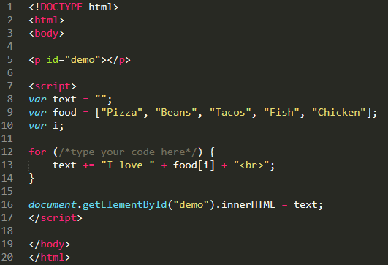
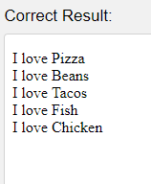
Assignment 16 due – 7/17/2018
Inside the for loop:
Set the counter variable (i) to 0.
Run the loop as long as i is less than the length of the food array.
Increment i by 1.

Slide 7
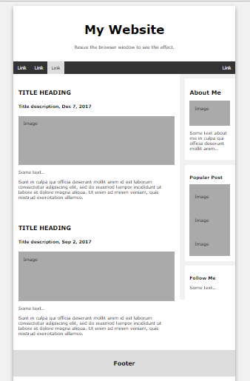
Project Assignment
You have to save the below assignment in your project folder.
Replace the text and fill your relevant information into the elements in index.html
Add relevant images.

